Slide 1


Smart Curated Security System
Let's talk about how it will be implemented!!

Slide 2

WE WILL BE DISCUSSING OUR IMPLEMENTATION PART IN THREE PARTS!!
Connecting mobile with the weight sensor
Calibration Method and Testing
Interfacing nRF24L01 with Arduino for BLE communication

Slide 3
LET'S TALK ABOUT FIRST IMPLEMENTATION OF CODE THAT IS FOR CONNECTING OUR MOBILE WITH THE WEIGHT SENSOR!!
In this project, we did not use any library for interfacing HX711 load sensor with Arduino. We have just followed the datasheet of HX711 and application notes. Although there are some libraries present for this purpose, where we need to include that library and we can get the weight using one line of code.
Include header file for LCD and defined the pins for the same -> Creating function for reading data from HX711 module and return its output -> initialize LCD and give directions to input and output pins in void setup() -> in void loop() function, we have read data from HX711 module and converted this data into weight (grams) and sent it to the LCD.

Slide 4
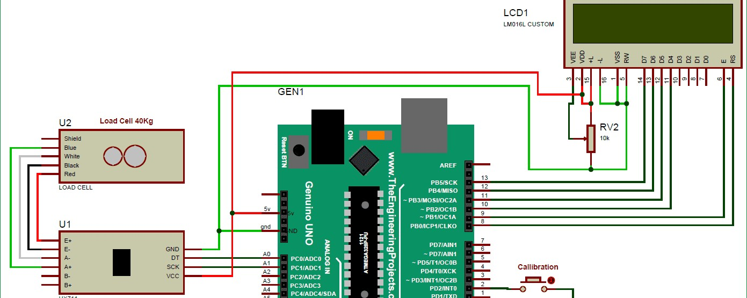
CIRCUIT DIAGRAM
16x2 LCD pins RS, EN, d4, d5, d6, and d7 are connected with pin number 8, 9, 10, 11, 12 and 13 of Arduino respectively. HX711 Module’s DT and SCK pins are directly connected with Arduino's pin A0 and A1.

Slide 5
CALIBRATION METHOD AND
The load cell is quite sensitive and depending on the changing environment, calibration may be essential. the zero (tare) value and a calibrated mass value.
TESTING
The simplest way to understand the calibration is to use the HX711 ADC reading with no added mass (tare). Then, once the zero value is calibrated, ask Arduino to again read the HX711 ADC value with a known calibration mass. This will create an up-to- date linear calibration slope and intercept, ensuring the most accurate weighing.

Slide 6
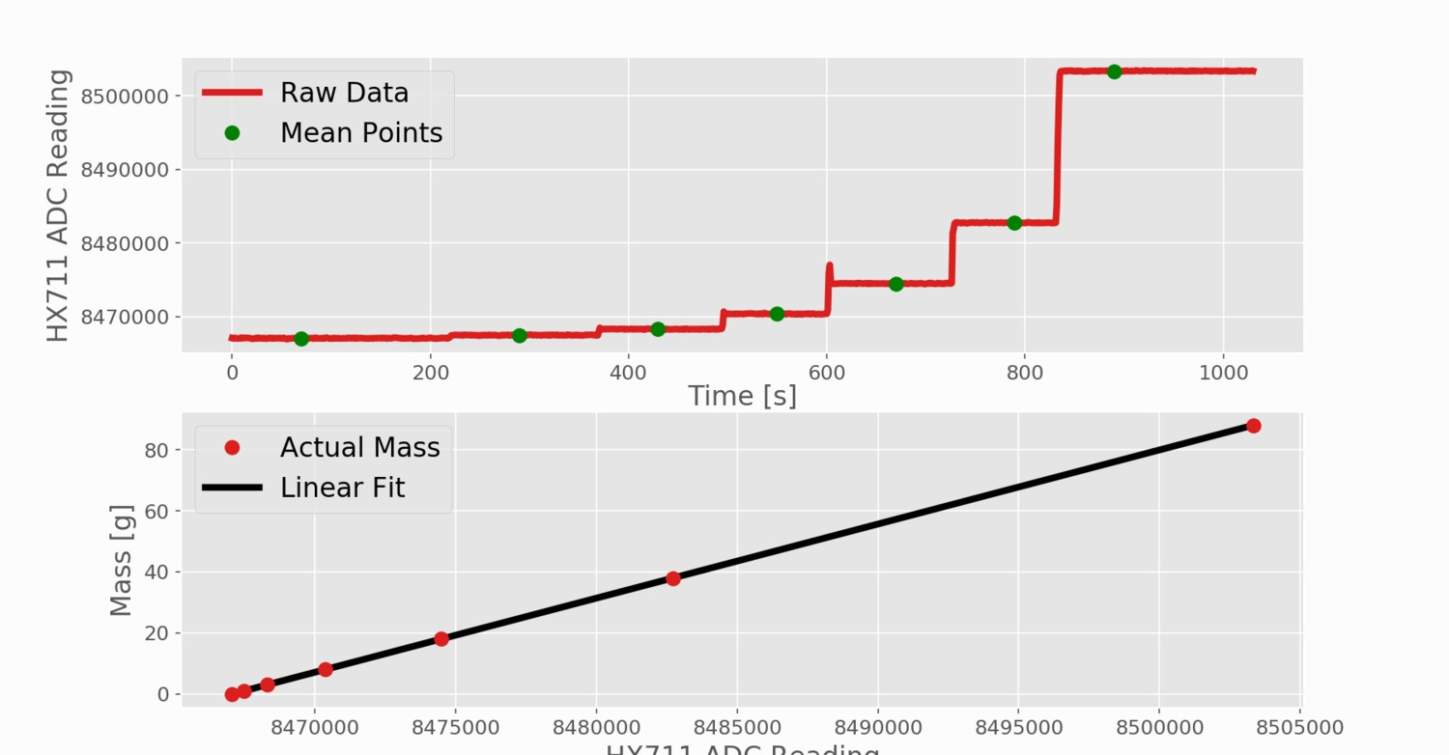
METHOD USING TWO CALIBRATION POINTS: THE ZERO VALUE AND A CALIBRATED MASS VALUE
Since strain gauges linearly relate strain to force applied, we are able to use a linear relationship when calibrating the load cell. The process of plotting several different calibrated masses against the load cell HX711 readout in order to verify this linearity at multiple strains. This plot is shown below:

Slide 7
The nRF24L01 works on SPI, so the interfacing will be using SPI Protocol. Now let's discuss the steps:
INTERFACING
NRF24L01 WITH ARDUINO FOR BLE COMMUNICATION
Include libraries -> Define and initialize the pins and functions for DHT11 and BLE module #define DHTPIN
#define DHTTYPE DHT11 -> Start the serial port
->Begin the DHT sensor and BTLE ->Save the value to Buffer and parse it to the BLE module.
This BLE will be used to send signal to camera from weight sensor so that it can capture image and send to owner.

Slide 8
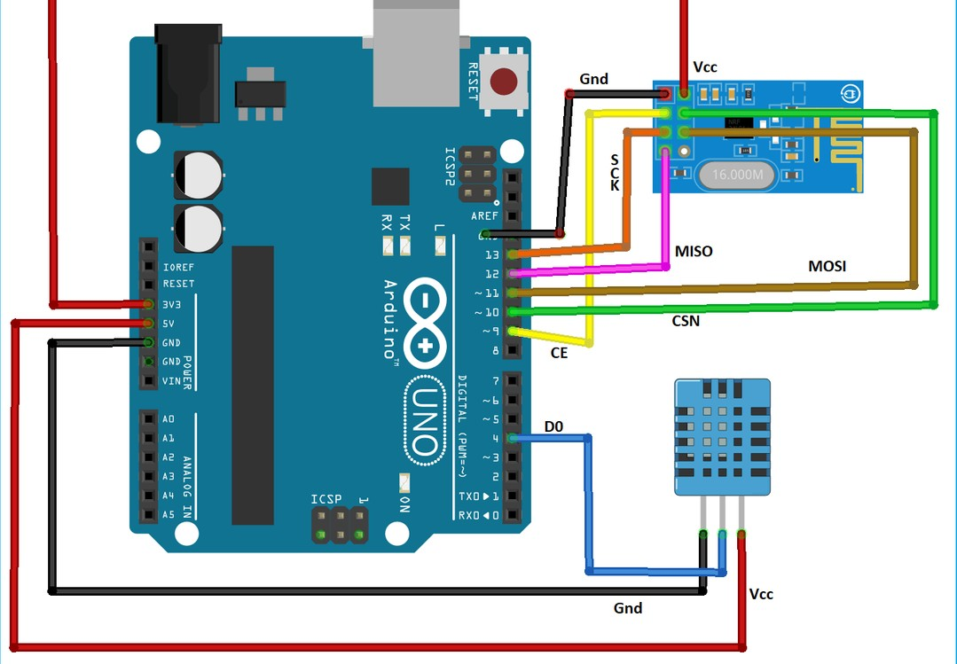
ARDUINO NRF24L01 MODULE CIRCUIT
The module has on operating voltage from 1.9V to 3.6V (typically 3.3V) and consumes very less current of only 12mA during normal operation. Also they have a wide address range of 125 unique ID’s, hence in a closed area we can use 125 of these modules without interfering with each other.
DIAGRAM

Slide 9
NOW LET'S TALK ABOUT SOME HEADER FILES AND LIBRARIES USED IN PROJECT!!
#include <SPI.h> #include <RF24.h> #include <BTLE.h> #include <DHT.h>
#include <LiquidCrystal.h>
#include <Q2HX711.h>
Firstly include the required libraries. The library includes RF24 to access nRF24L01 commands, DHT11 library for accessing DHT11 commands and BTLE library to use BLE functions.
We have included header file for LCD
Arduino-based weighing scale

Slide 10

W E A R E R E A D Y
FOR YOUR QUESTIONS!!

